Slide 1
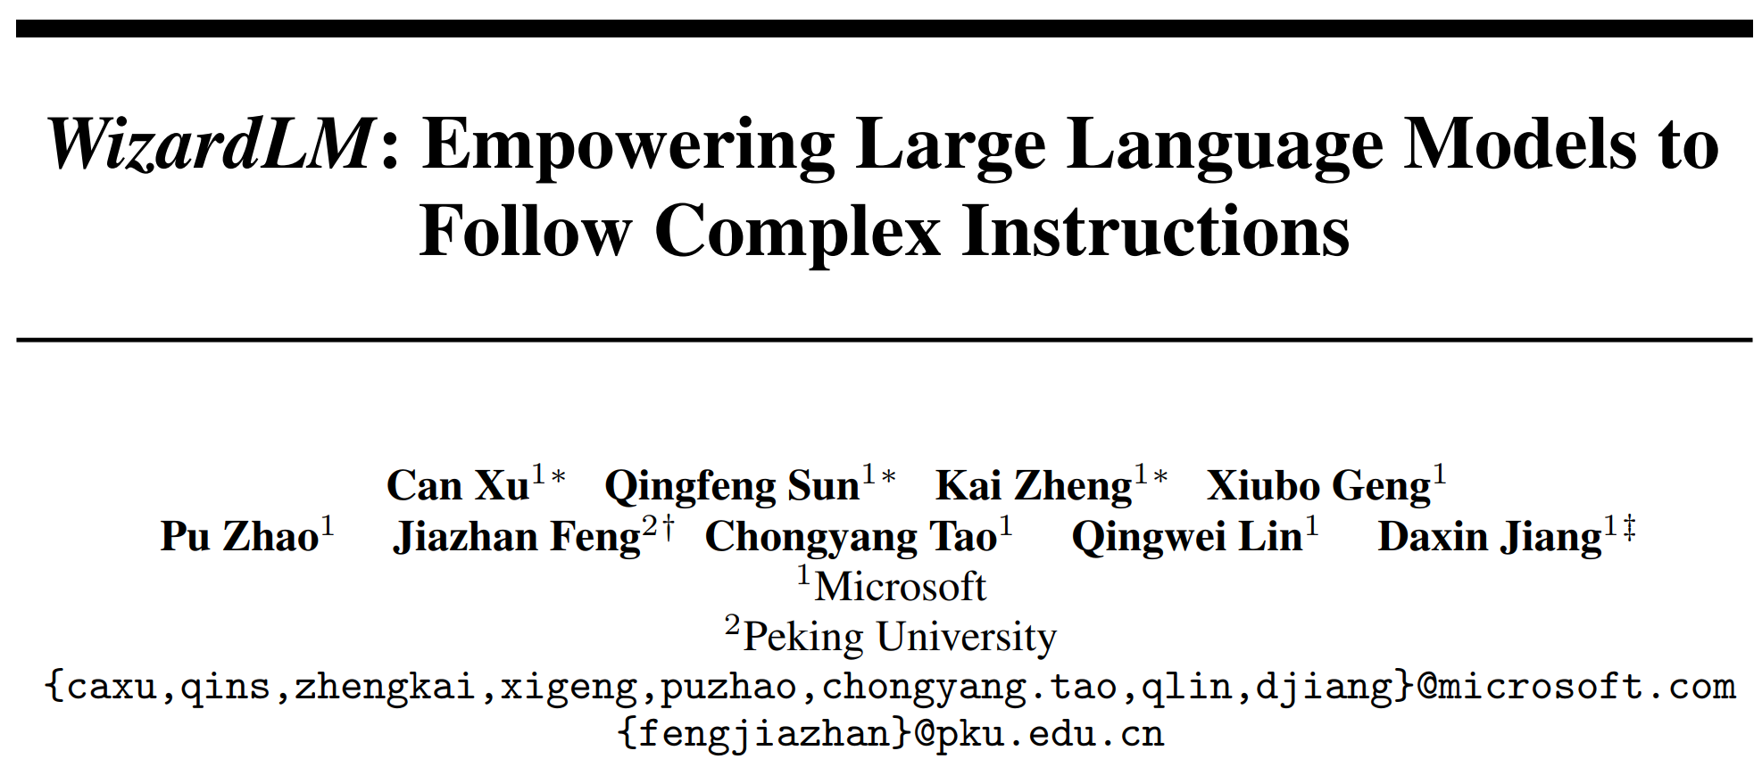
arXiv 2304.12244
Preprint. Under review.

Slide 2
Abstract
Background
Instruction-tuning on LLMs are successful.
Limitation of existing method
Manual data creation is time-consuming and labor-intensive.
Human may struggle to produce high-complexity instructions.
Our method
Initial instructions -> rewrite into more and more complex instructions.

Slide 3
Abstract
Advantage of our method
We can create many instruction data with varying levels of complexity using LLMs instead of humans.
Experimental results
We fine-tune LLaMA with all generated data mixed.
(Human eval) Our instructions are better than human-created ones.
(Human eval) Our output is preferred to outputs from ChatGPT on high complexity part.
(GPT-4 auto eval) >90% capacity of ChatGPT on 17 (of 29) skills.

Slide 4
Introduction – Previous methods
Closed-domain instruction-tuning
Some manual instructions for each dataset.
Drawbacks of closed-domain instruction-tuning
Many samples, a few instructions => lack of diversity.
The instructions usually only ask for one task, but real-life human instructions often have multiple and varied tasks demands.
Open-domain instruction-tuning
Great success from OpenAI. See also ShareGPT and self-instruct.
Drawbacks of OpenAI’s method
Annotating process is expensive and time-consuming.
These instructions are mostly easy or moderate with few hard ones.

Slide 5
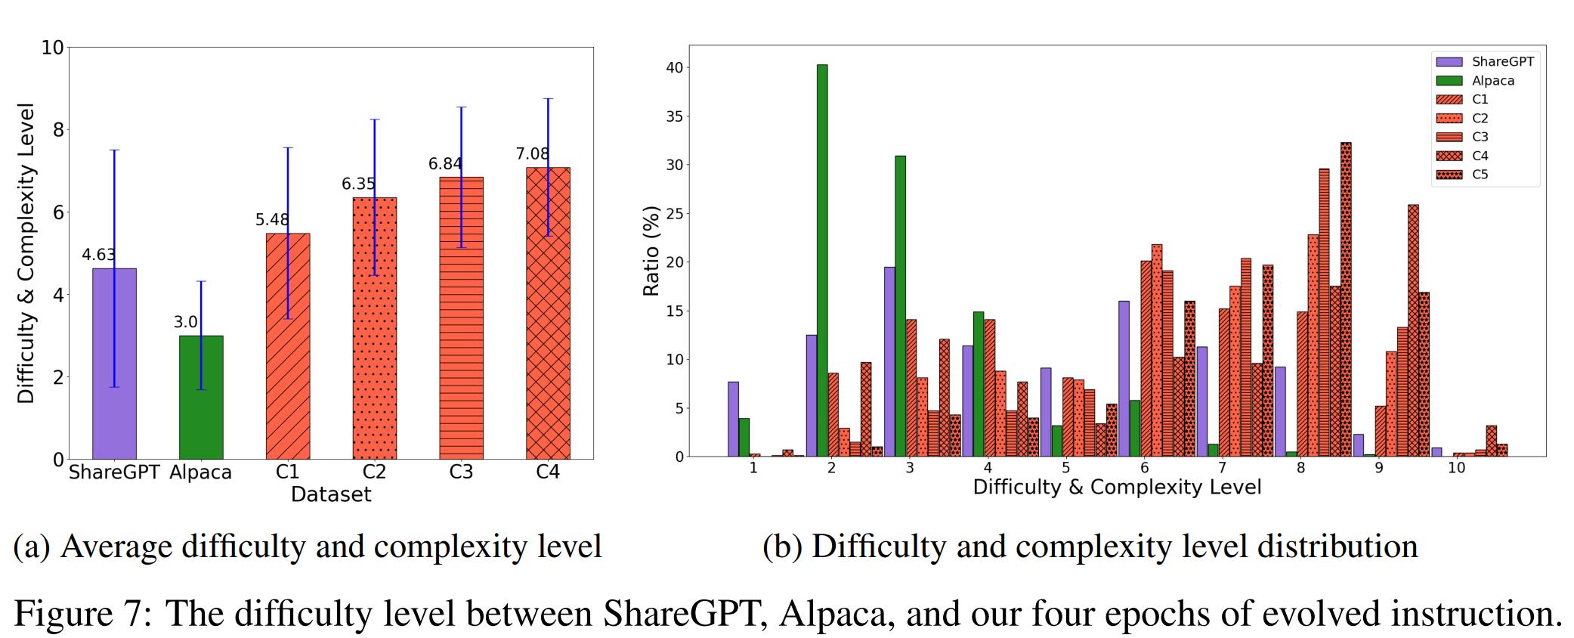
Introduction – Difficulty level distribution
*Difficulty level is judged by GPT-3.5 from 1 to 10.

Slide 6
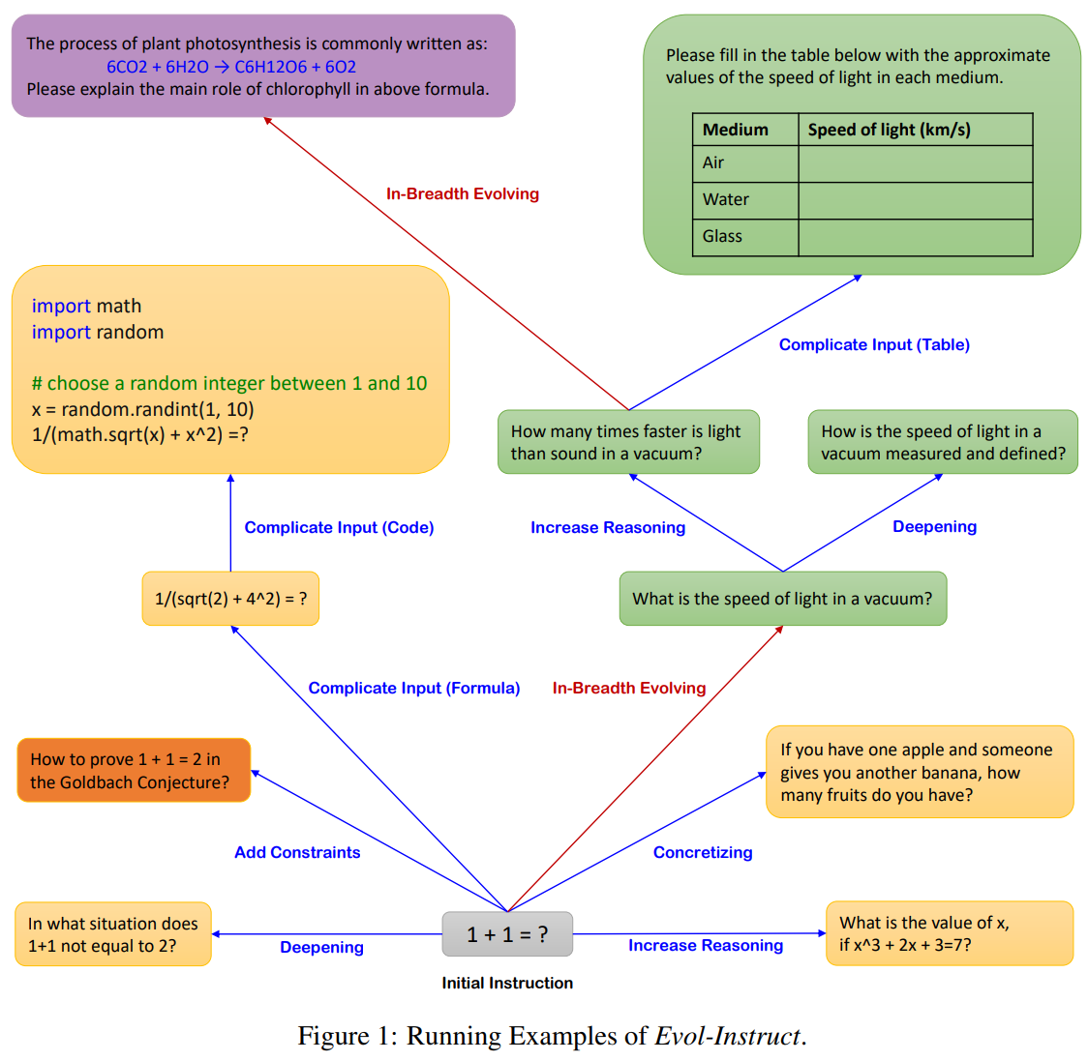
Example

Slide 7
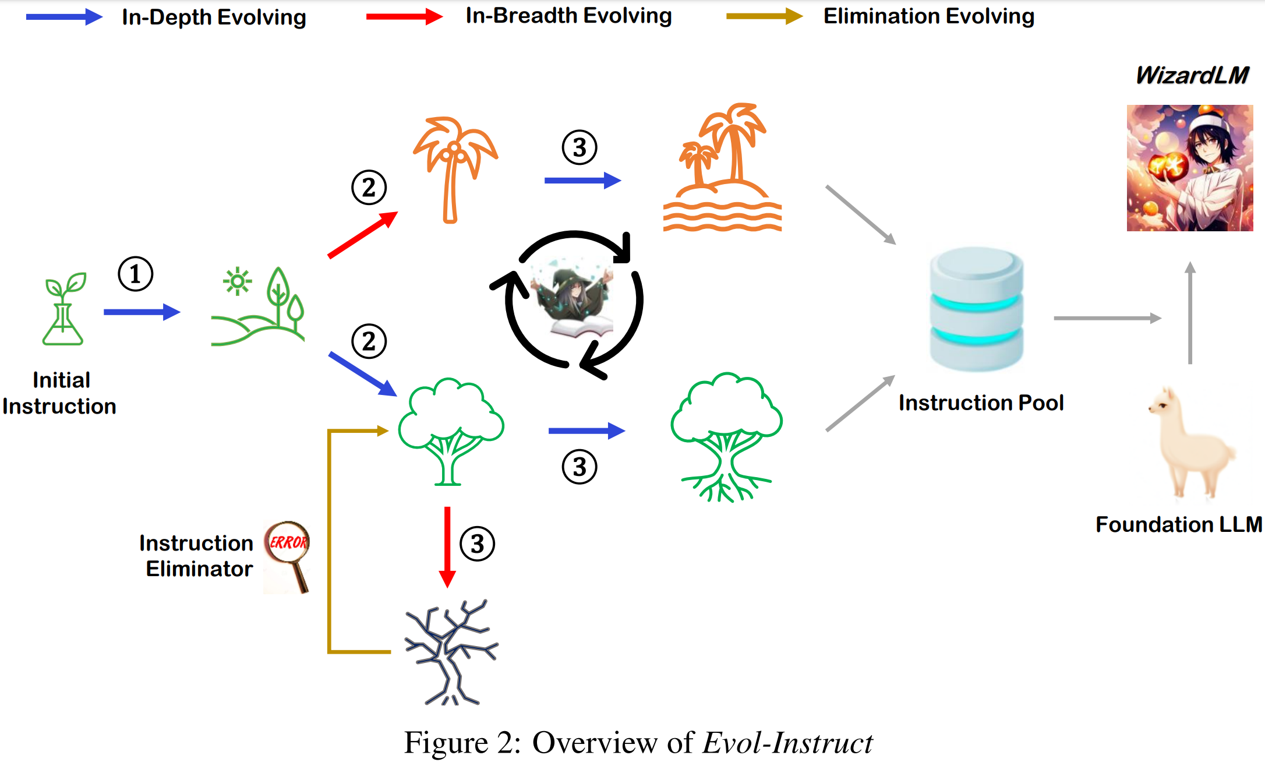
Approach

Slide 8
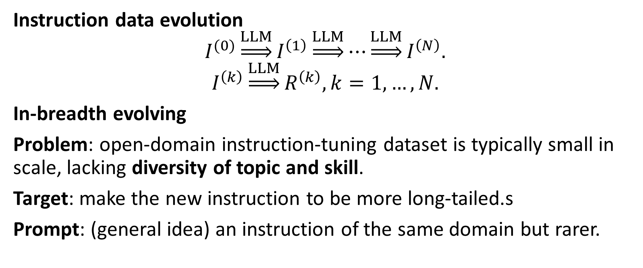
Approach
Instruction data evolution
$$I^{(0)}\underset{⇒}{LLM}I^{\left(1\right)}\underset{⇒}{LLM}⋯\underset{⇒}{LLM}I^{\left(N\right)}.$$
$$I^{\left(k\right)}\underset{⇒}{LLM}R^{\left(k\right)}, k=1,…,N.$$
In-breadth evolving
Problem: open-domain instruction-tuning dataset is typically small in scale, lacking diversity of topic and skill.
Target: make the new instruction to be more long-tailed.s
Prompt: (general idea) an instruction of the same domain but rarer.

Slide 9
Approach
... Your objective is to rewrite a given prompt into a more complex version to make those famous AI systems (e.g., ChatGPT and GPT4) a bit harder to handle. But the rewritten prompt must be reasonable and must be understood and responded by humans. ...
In-depth Instruction evolver
Different prompt for different evolver.
Adding constraints;
Deepening;
Concretizing;
Increased reasoning steps;
Complicating input (use in-context examples).
Difficulty control: evolution should be a bit harder; add 10-20 words.

Slide 10
Approach
Response generation
Use LLM to generate corresponding responses.
Elimination evolving
Evolution fails sometimes. We classify 4 situations as failure:
Evolved version provides no information gain (judged by ChatGPT).
Too difficult (when response contains sorry and is too short).
Response contains only punctuation and stop words.
Evolved version obviously copies some words from the prompt.

Slide 11
Experimental details
Initial seed dataset: Alpaca’s 52k dataset.
Prompt evolver etc.: gpt-3.5-turbo.
Evolution rounds: 4.
API request times: 52k × 4 × 3 = 624k.
Base model: LLaMA 7B.
Instruction dataset size: 70k (sampled from the 250k total dataset).
Baselines: Alpaca, Vicuna-7B and ChatGPT.
Test set: self-collected 218 instances from (unclear) diverse sources. Reported to be more diverse and require more skills.

Slide 12
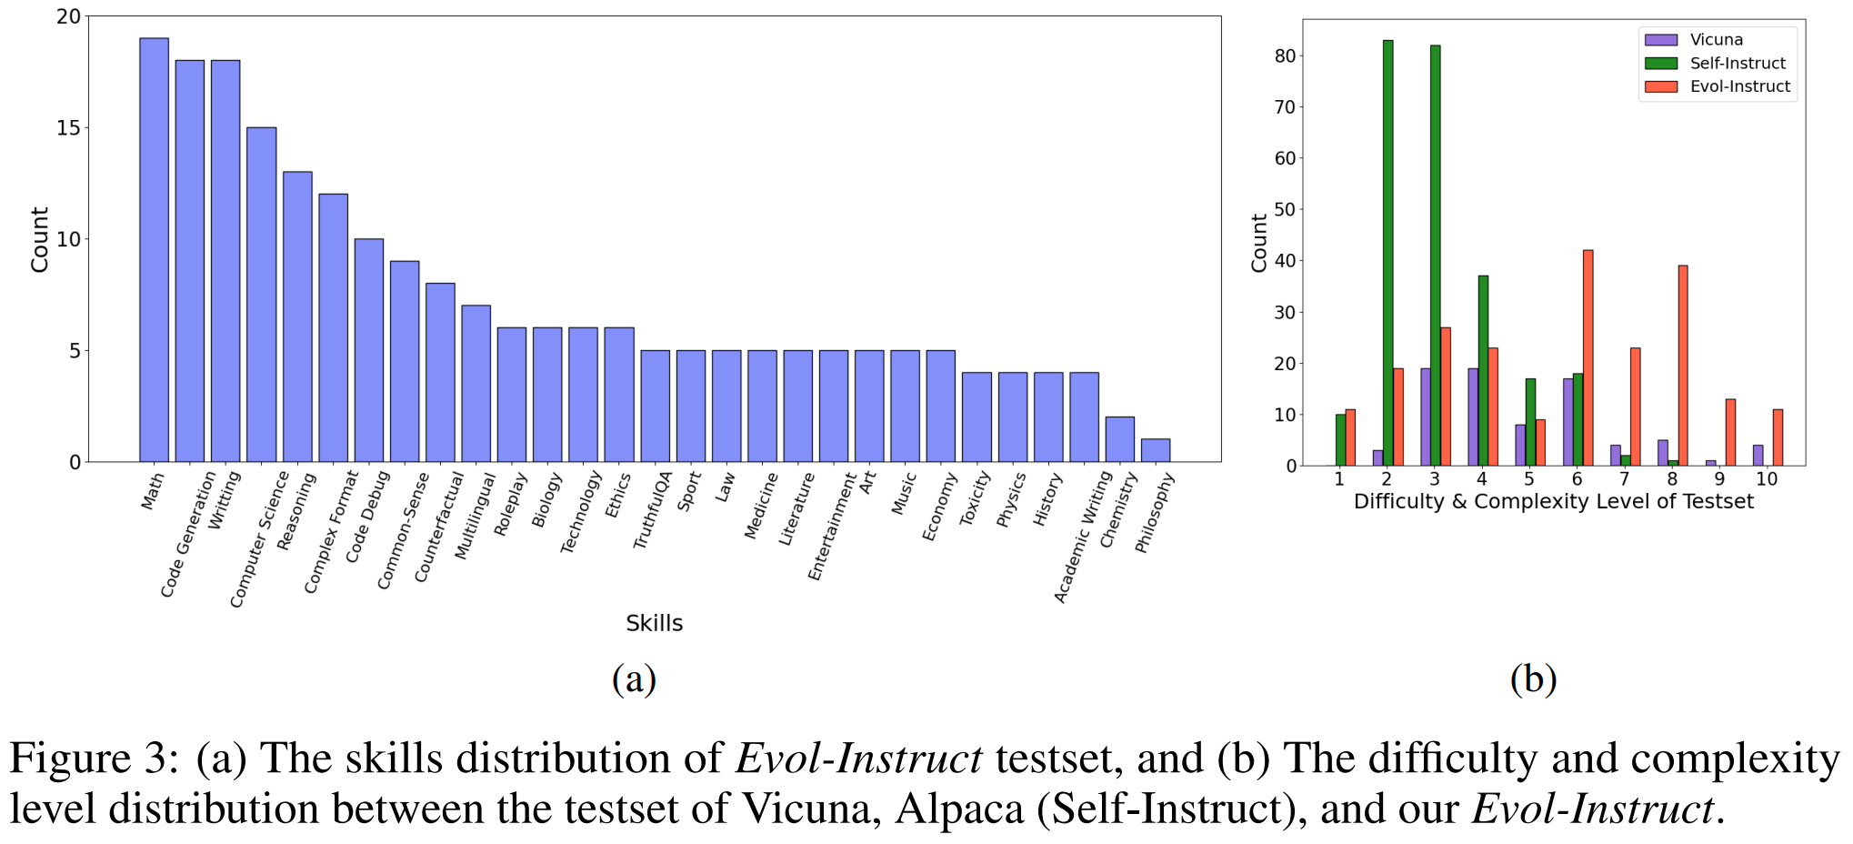
Test set

Slide 13
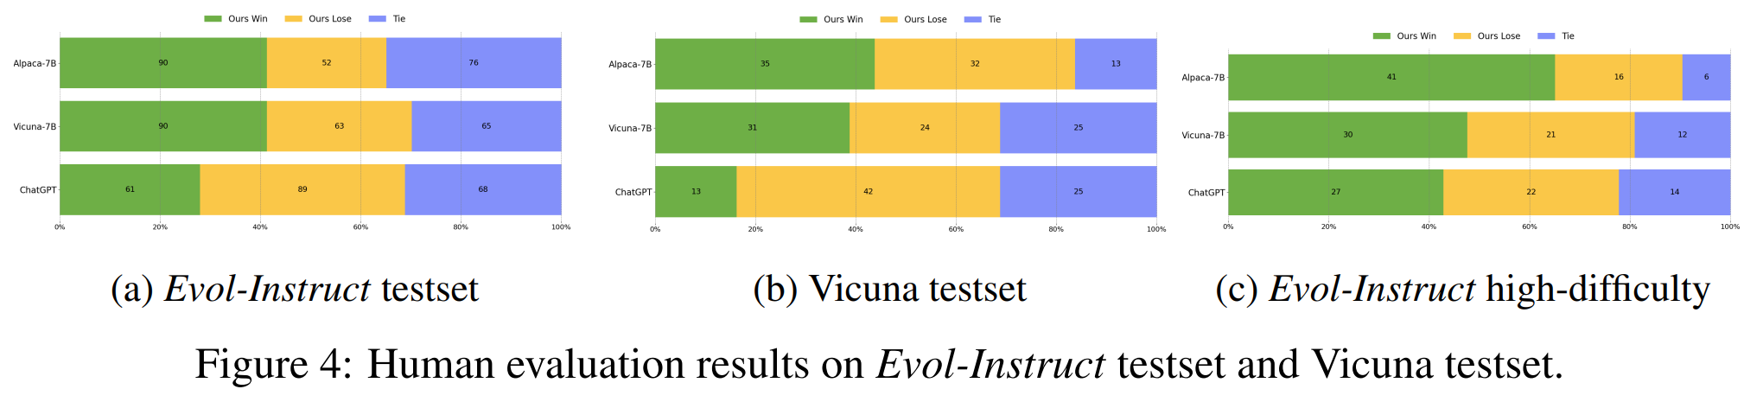
Human evaluation
We recruit 10 annotators to judge which response is better.
Aspects: Relevance, knowledgeable, reasoning, calculation, accuracy.

Slide 14
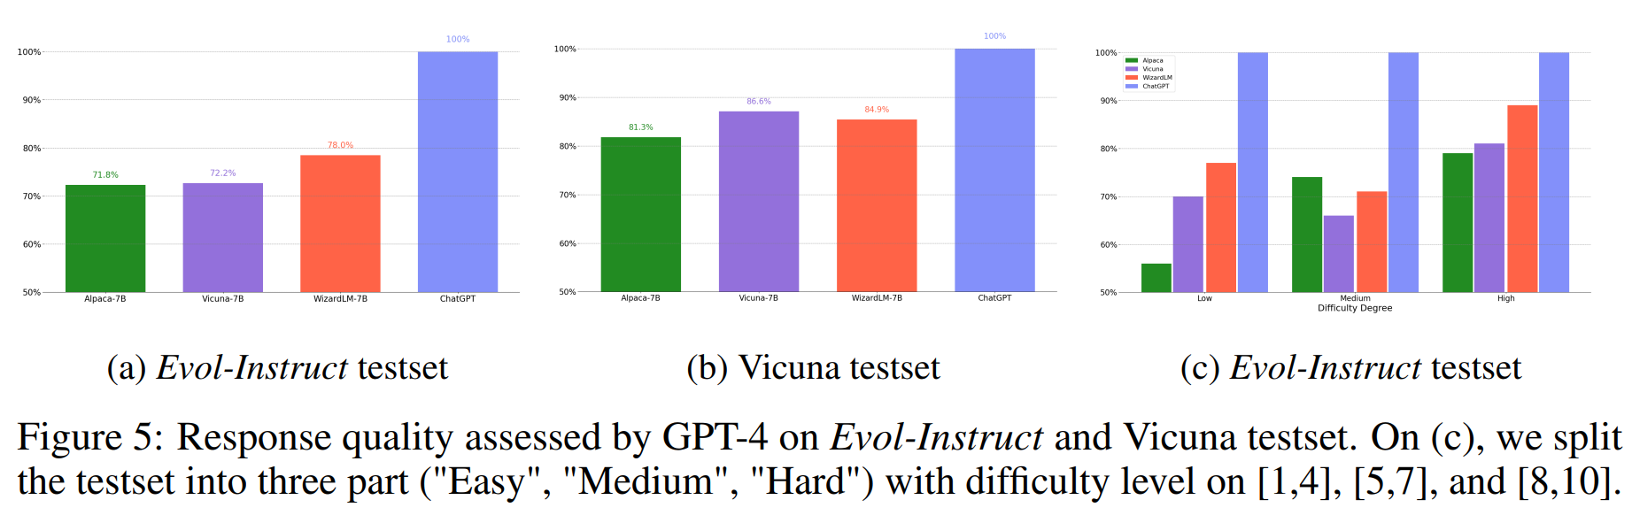
GPT-4 automatic evaluation

Slide 15
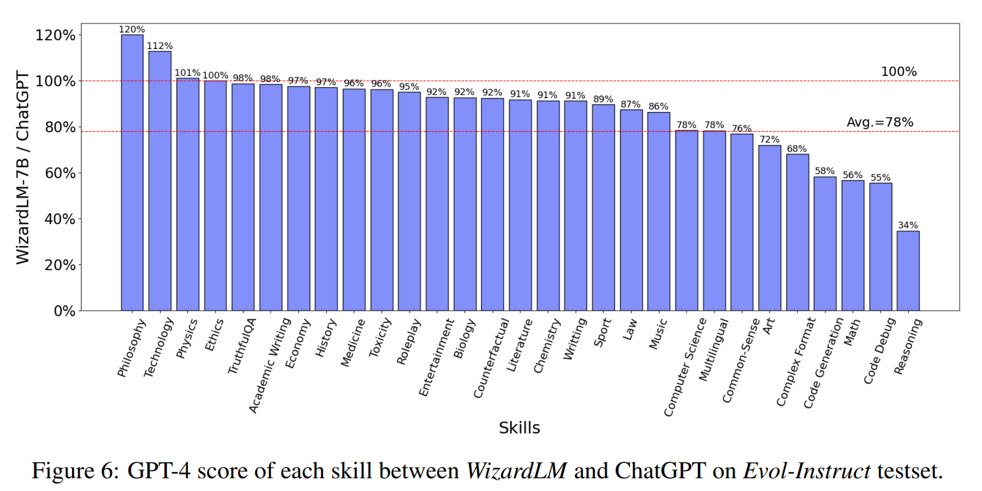
GPT-4 automatic evaluation

Slide 16
Discussion – depth of instructions

Slide 17
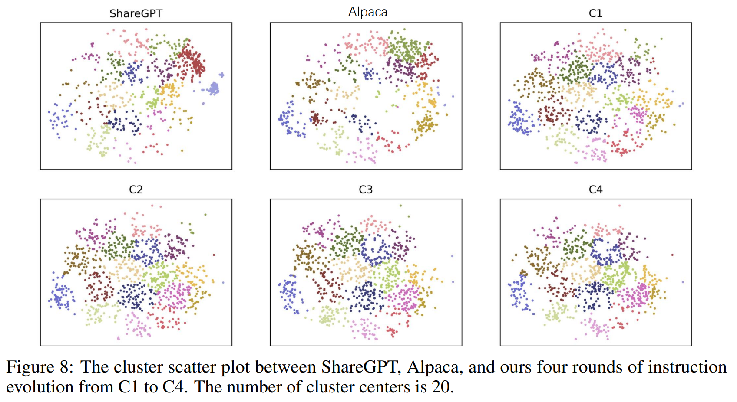
Discussion – breadth of instructions

Slide 18
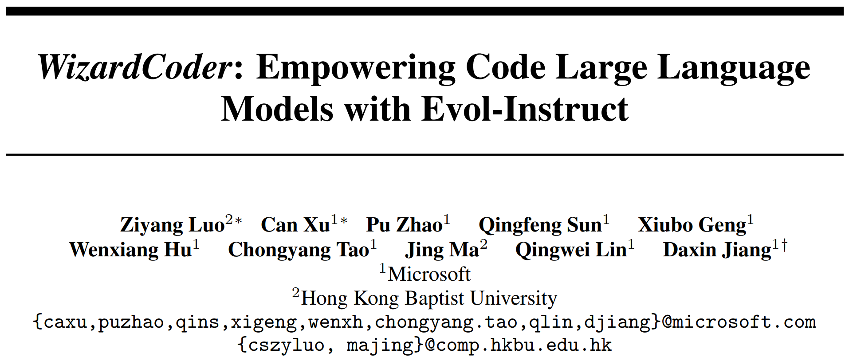
arXiv 2306.08568
Preprint. Under review.

Slide 19
Abstract
Most existing code LLMs are trained on raw code data without instruction fine-tuning.
We adapt the Evol-Instruct method to the domain of code, and fine-tune Code LLMs with complex instruction fine-tuning.
Our performance surpasses all other open-source Code LLMs by a substantial margin, on HumanEval, HumanEval+, MBPP and DS-1000.
We even outperform Claude and Bard on HumanEval and HumanEval+.
We open-source our code, model and (still no) data at GitHub.

Slide 20
Introduction
Most Code LLMs emphasize the pre-training process.
Instruction tuning shows great success in NLP, but is not well explored in the code domain.
We adapt the Evol-Instruct method from WizardLM into the code domain to enhance SOTA open-source Code LLM’s performance.

Slide 21
Approach – Instruction generation
We adapt the Evol-Instruct from WizardLM to the code domain.
Difference from WizardLM
Remove deepening, complicating input and in-breadth evolving.
Unify the evolution prompt template.
Add code-specific evolution instruction
Code debugging;
Time-space complexity constraints.

Slide 22
Prompt template
Please increase the difficulty of the given programming test question a bit.
You can increase the difficulty using, but not limited to, the following methods:
{method} (one of 5 evolution methods in next slide)
{question} (NL in code generation)

Slide 23
Evolution methods
Add new constraints and requirements to the original problem, adding approximately 10 additional words.
Replace a commonly used requirement in the programming task with a less common and more specific one.
If the original problem can be solved with only a few logical steps, please add more reasoning steps.
Provide a piece of erroneous code as a reference to increase misdirection.
Propose higher time or space complexity requirements, but please refrain from doing so frequently.

Slide 24
Approach – Instruction tuning
Below is an instruction that describes a task, paired with an input that provides further context. Write a response that appropriately completes the request.
### Instruction:
{instruction} (NL in code generation)
### Response:

Slide 25
Experimental details
Foundation model: StarCoder.
Seed instruction-following dataset: Code Alpaca (20k).
We iterately evolve the dataset, using HumanEval as validation set.
Hyperparameters:
Batch size: 512;
Sequence length: 2048;
Fine-tuning steps: 200 (warmup: 30);
Lr: 2e-5.

Slide 26
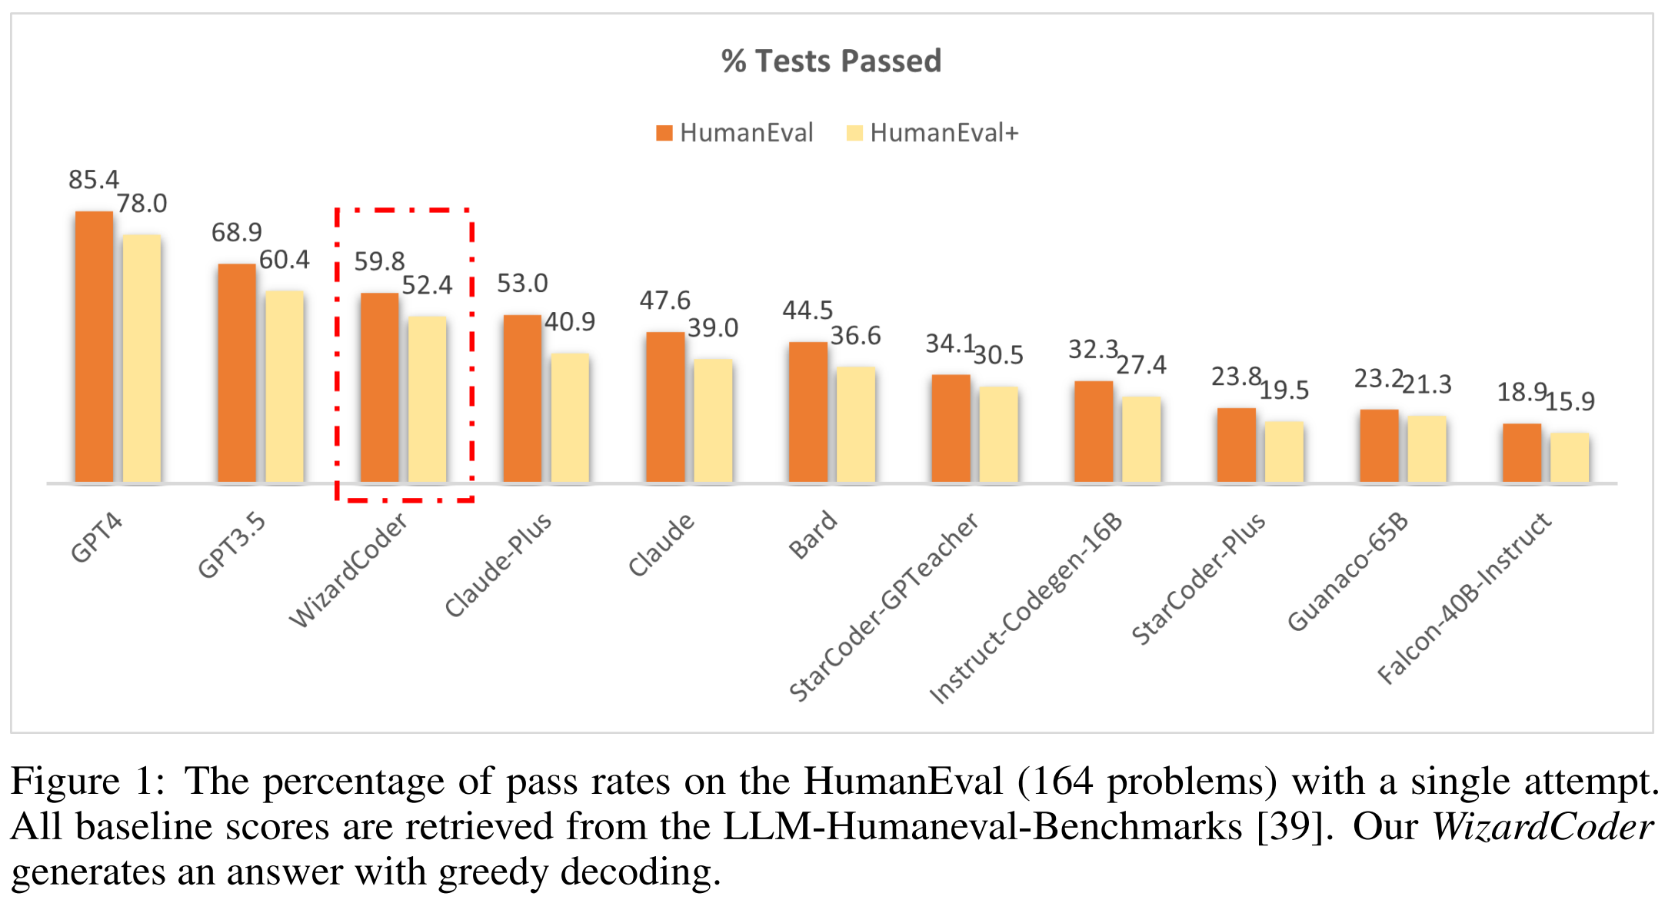
Experimental results – pass@1 (greedy)

Slide 27
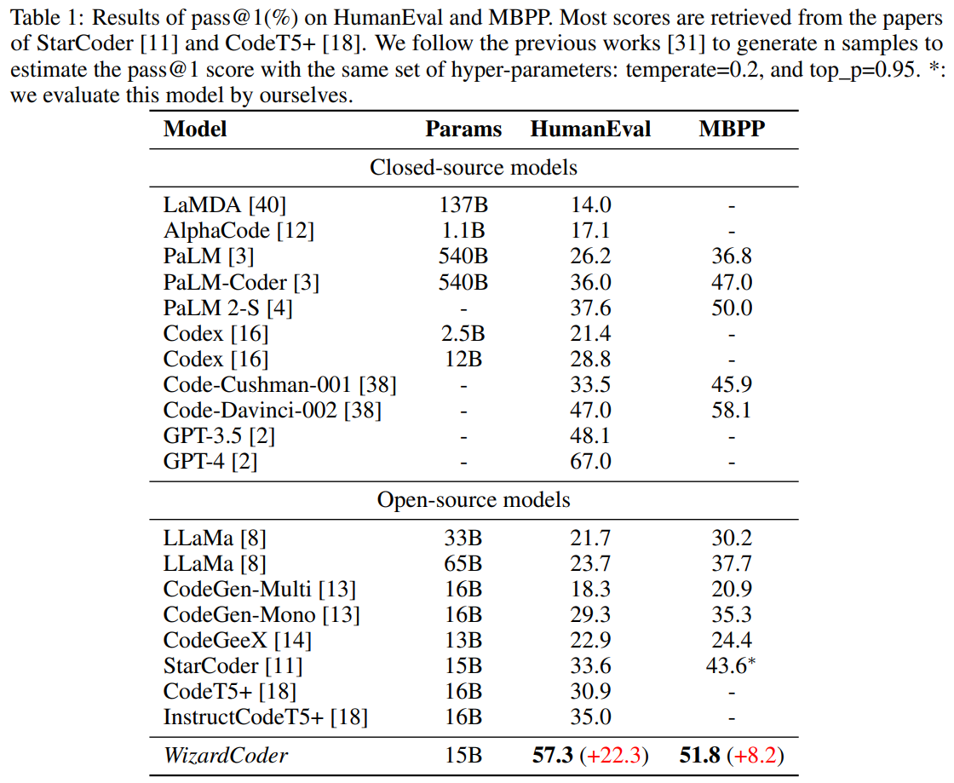
Experimental results – pass@1 (top-p)

Slide 28
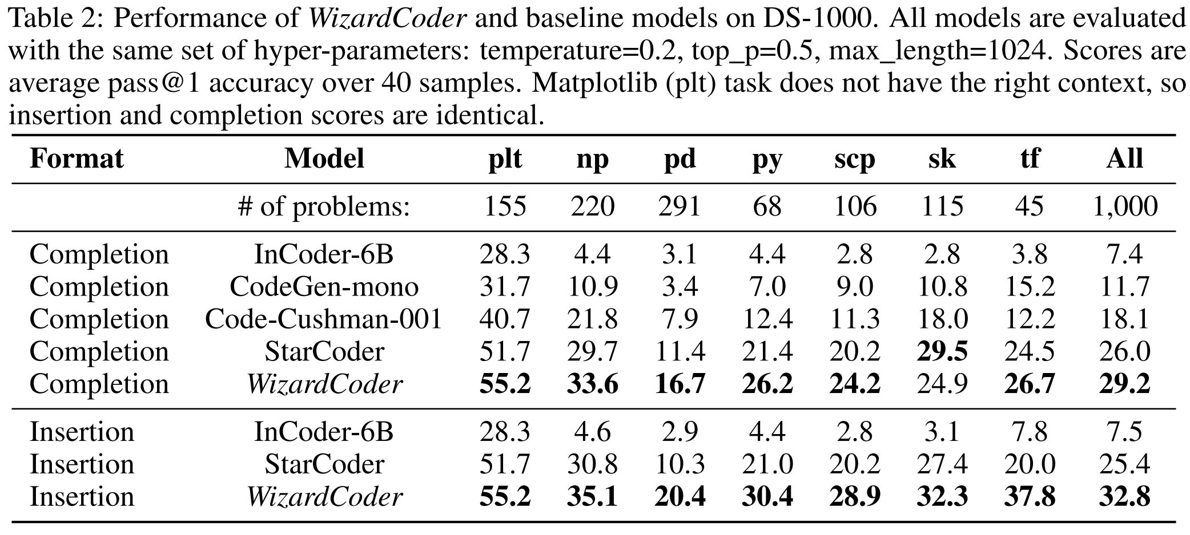
Experimental results – DS-1000

Slide 29
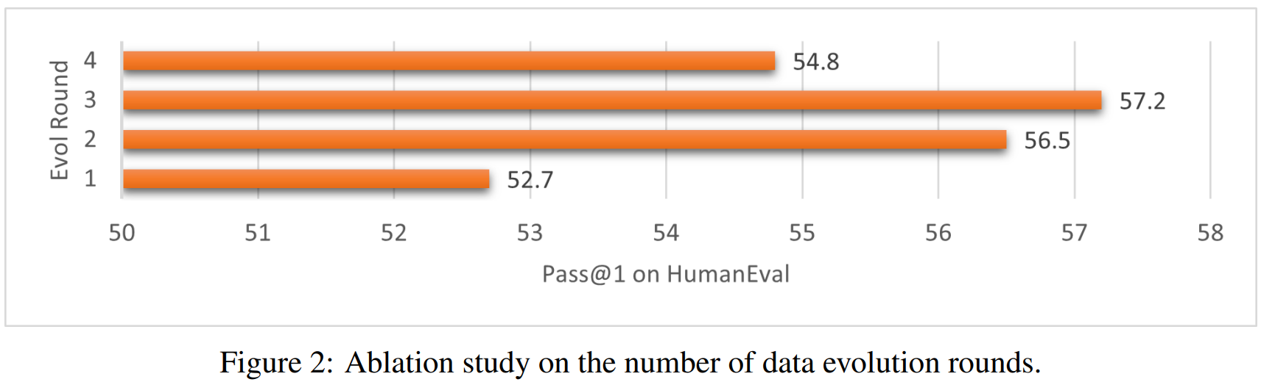
Ablation study
20k => (1) 38k => (2) 58k => (3) 78k => (4) 98k

Slide 30
Why talk about this work?
Its performance, even only after one iteration.
Unclear things (partly from its GitHub issues):
The dataset after evolution is not open-sourced. Yes, only the model is. The whole project looks pretty propaganda-centric.
Use HumanEval as validation set??? The result is still really impressive only after 1 iteration.
20k + 20 k = 38k? There must be some filtering not mentioned in the paper.
What is the model used for evolution? Unclear, probably GPT-3.5 or GPT-4.
No ablation study of StarCoder trained on un-evolved Code Alpaca. Yes, this is a true weakness.
This is just model distillation! I think it is acceptable to consider it only a distillation work. But such performance in such a small model is still impressive.

Slide 31
Reproducibility
The dataset is not open-sourced. Is this reproducible?
Nickrosh/evol-teacher (🤗nickrosh/Evol-Instruct-Code-80k-v1)
Use GPT-3.5 to iterate Code Alpaca dataset for 3 rounds.
Improve ReplitLM’s performance on HumanEval from 21% to 31.1%.
swtheing/WizardCoder_Instruct_Generator
Upload the evolved dataset, but no model metrics etc.

